Slide 1
Intro to
AI/ML
Session-1

Slide 2


About Speaker
Niranjay Ajayan
Muhammed Shamil
Vice Chairperson
NSDC MEC
AI / ML Co Lead
NSDC MEC

Slide 3
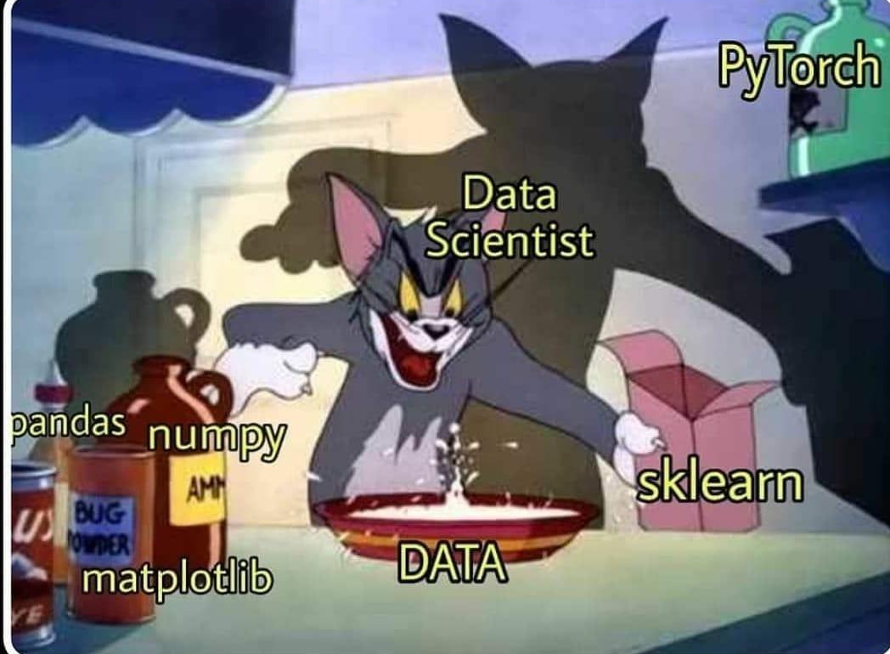
What is Machine Learning ?
Machine learning (ML) is a branch of artificial intelligence (AI) focused on enabling computers and machines to imitate the way that humans learn, to perform tasks autonomously, and to improve their performance and accuracy through experience and exposure to more data.

Slide 4
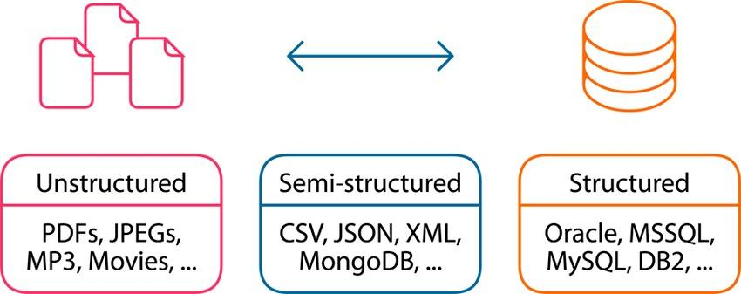
Understanding Data
Data can be categorized based on its organization and format.
Three main types:
Structured Data
Unstructured Data
Semi-Structured Data

Slide 5
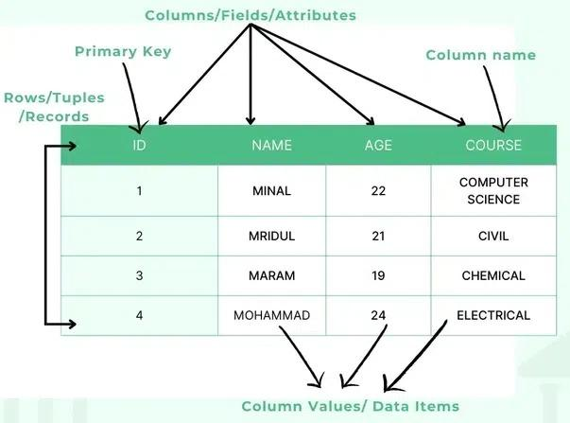
Structured Data
Well-organized in rows and columns.
Stored in relational databases (RDBMS).
Easily searchable using SQL.
Schema-defined: fixed data model and format.
Examples:
Excel sheets
SQL databases

Slide 6
Types of Structured Data
1. Numerical Data
Quantitative values.
Used for mathematical operations.
Continuous (can take any value within a range — e.g., height, temperature, time)
Discrete (specific, countable values — e.g., number of students, days, cars)
2. Categorical Data
Represents distinct groups or classes.
Can be: Nominal (no order): Gender, colors, city names. Ordinal (ordered): Ratings (low, medium, high), class levels.

Slide 7
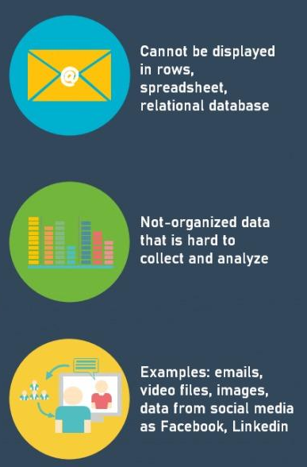
Unstructured Data
No predefined format or schema.
Difficult to search, process, and analyze.
Requires AI, NLP, or machine learning for processing.
Examples:
Images, audio, and video files
Social media posts
Emails, PDFs, scanned documents

Slide 8
Types of Unstructured Data
1. Text Data
Human-readable, free-form text
Includes:Emails,Chat logs
2. Image Data
Visual data in formats like JPEG, PNG, BMP
Can be raw pixel data or compressed images Other Datas-
audio, and video files
Social media posts
Emails, PDFs, scanned documents.

Slide 9
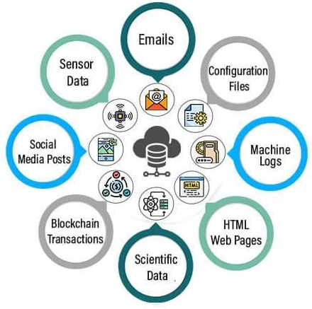
Semi-Structured Data
Does not follow strict tabular structure, but has some organizational elements (tags, markers).
Easier to store than unstructured, more flexible than structured.
Common in NoSQL databases and data exchange formats.
Examples:
JSON, XML, YAML
Email headers (To, From, Subject)
Log files, HTML pages

Slide 10
Types of Machine Learning
1)Supervised Machine Learning
Supervised learning is when a model is trained on a labelled dataset.
Labelled datasets contain both input features and corresponding output labels.
The algorithm learns to map the relationship between inputs and correct outputs.
Both training and validation datasets are labelled.
The model is used to predict outputs for new, unseen input data.

Slide 11
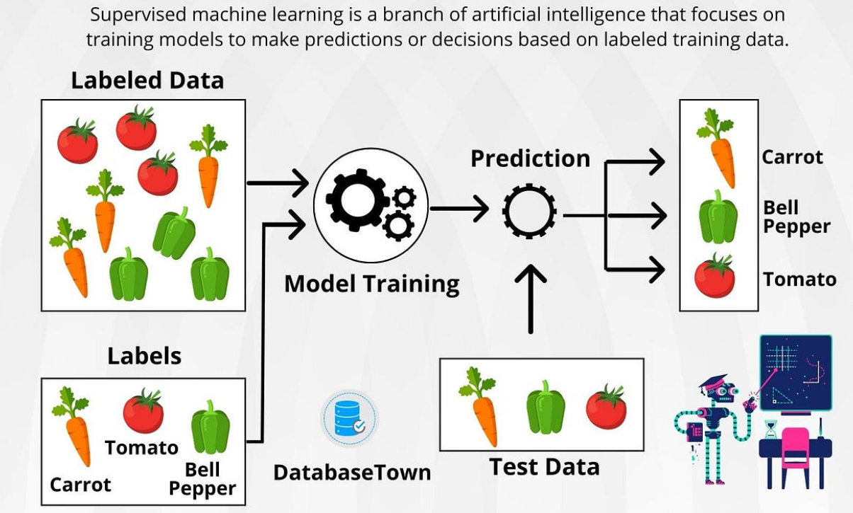

Slide 12
2) Unsupervised Machine Learning
Unsupervised learning is a machine learning technique that uses unlabeled data.
The algorithm identifies patterns and relationships in the data without any labeled target outputs.
No supervision or predefined output is provided during training.
The goal is to discover hidden structures, patterns, similarities, or clusters in the data.
Useful for tasks like data exploration, visualization, dimensionality reduction, and clustering

Slide 13
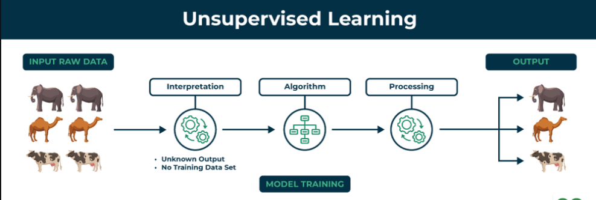

Slide 14
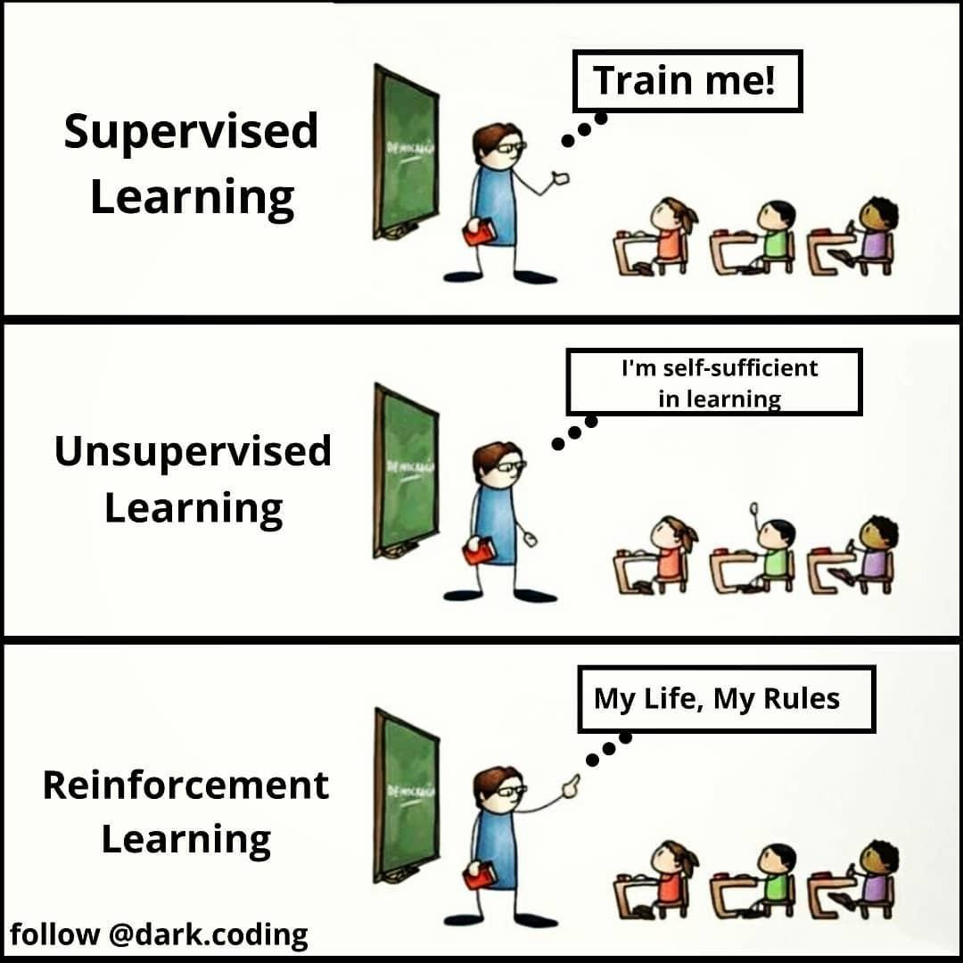
3) Reinforcement Learning
Reinforcement Learning (RL) is a branch of machine learning focused on decision-making through trial and error.
Agents learn by interacting with an environment.
Feedback is received based on the actions taken by the agent.
Feedback is given in the form of rewards (for good actions) or penalties (for bad actions).
The goal is to maximize cumulative rewards over time.

Slide 15
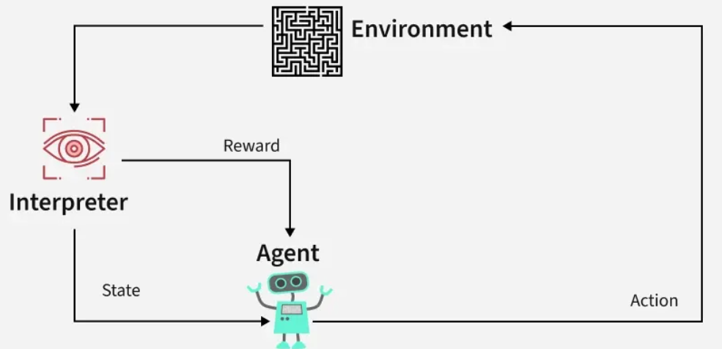

Slide 16
Prerequisites - Numpy
NumPy is a Python library used for working with arrays.
It also has functions for working in domain of linear algebra, fourier transform, and matrices.
Eg:
import numpy as np
# Inputs (house size in 1000 sq. ft)
X = np.array([1.0, 2.0, 3.0])
w = 150 # price per 1000 sq.ft
b = 50 # base price
y_pred = w * X + b
print(y_pred)
Output:
[200. 350. 500.]

Slide 17
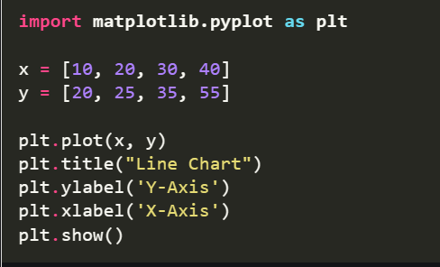
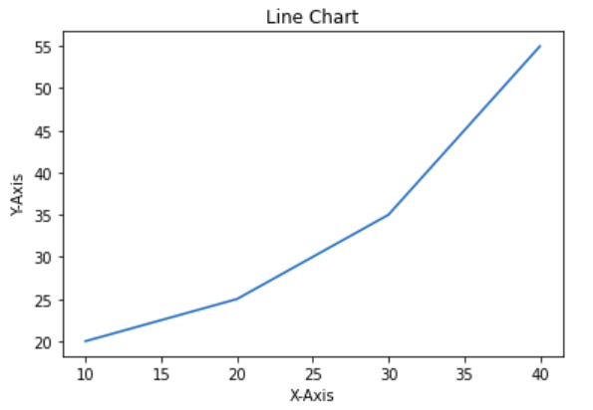
MATPLOTLIB
Matplotlib is a widely-used Python library used for creating static, animated and interactive data visualizations. It is built on the top of NumPy and it can easily handles large datasets for creating various types of plots such as line charts, bar charts, scatter plots, etc.

Slide 18
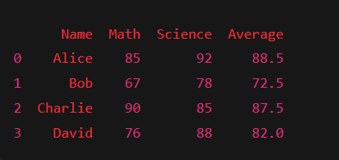
PANDAS
Pandas is a Python library used for working with data sets.
It has functions for analyzing, cleaning, exploring, and manipulating data.
eg:
import pandas as pd
data = {
'Name': ['Alice', 'Bob', 'Charlie', 'David'],
'Math': [85, 67, 90, 76],
'Science': [92, 78, 85, 88]
}
# Create a DataFrame
df = pd.DataFrame(data)
# Compute average score per student
df['Average'] = (df['Math'] + df['Science']) / 2
print(df)

Slide 19
Classification Algorithms
Logistic Regression
Logistic Regression is a supervised machine learning algorithm used for classification problems.
Unlike linear regression which predicts continuous values it predicts the probability that an input belongs to a specific class.
It is used for binary classification where the output can be one of two possible categories such as Yes/No, True/False or 0/1.
It uses sigmoid function to convert inputs into a probability value between 0 and 1

Slide 20
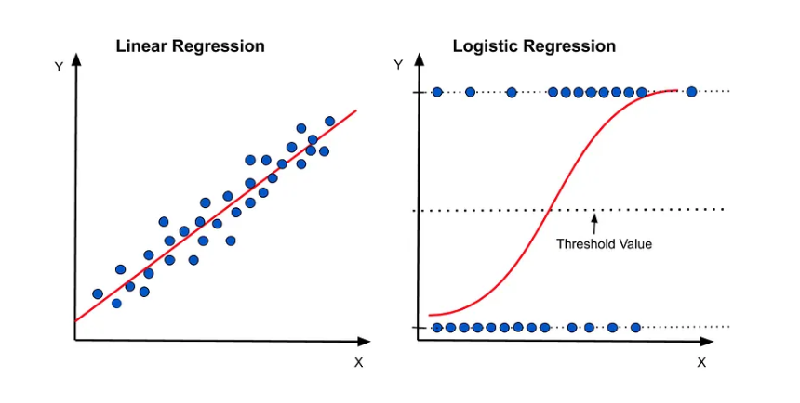

Slide 21
Support Vector Machine(SVM)
Support Vector Machine (SVM) is a supervised machine learning algorithm used for classification and regression tasks.
It tries to find the best boundary known as hyperplane that separates different classes in the data.
It is useful when you want to do binary classification like spam vs. not spam or cat vs. dog.
The main goal of SVM is to maximize the margin between the two classes.
The larger the margin the better the model performs on new and unseen data.

Slide 22
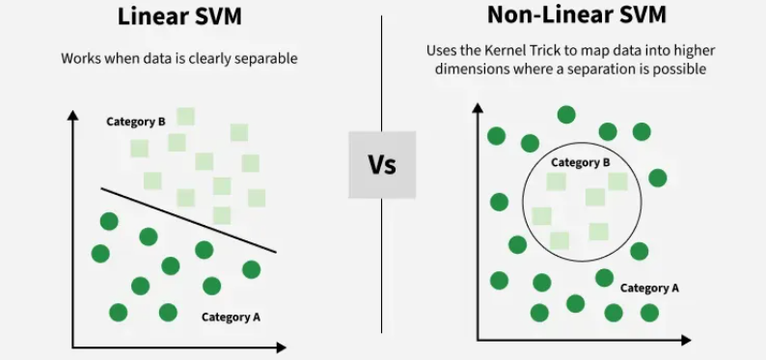

Slide 23
Introduction to KNN
KNN stands for K-Nearest Neighbors
It's a supervised learning algorithm
Can be used for both:
Classification: Predicting labels (e.g., cat vs. dog).
Regression: Predicting values (e.g., house price).
It's a lazy learner:
No learning during training time.
All the work happens during prediction.

Slide 24
How KNN Works
Choose a value for K (e.g., 3 or 5)
Measure distance from the new data point to all others (commonly Euclidean)
Identify the K nearest neighbors
Predict:
Classification: Most frequent label among K neighbors
Regression: Average value of K neighbors

Slide 25
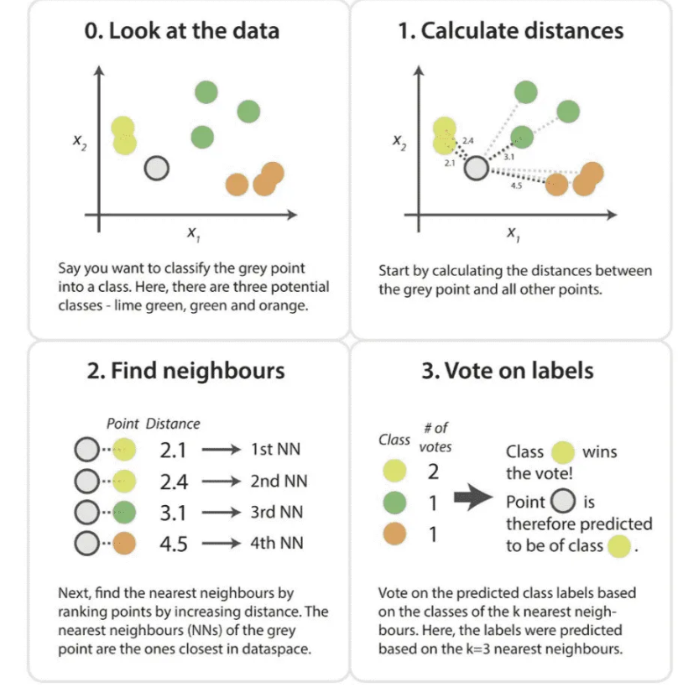
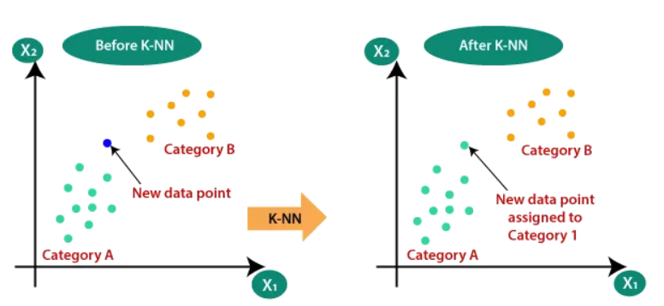

Slide 26
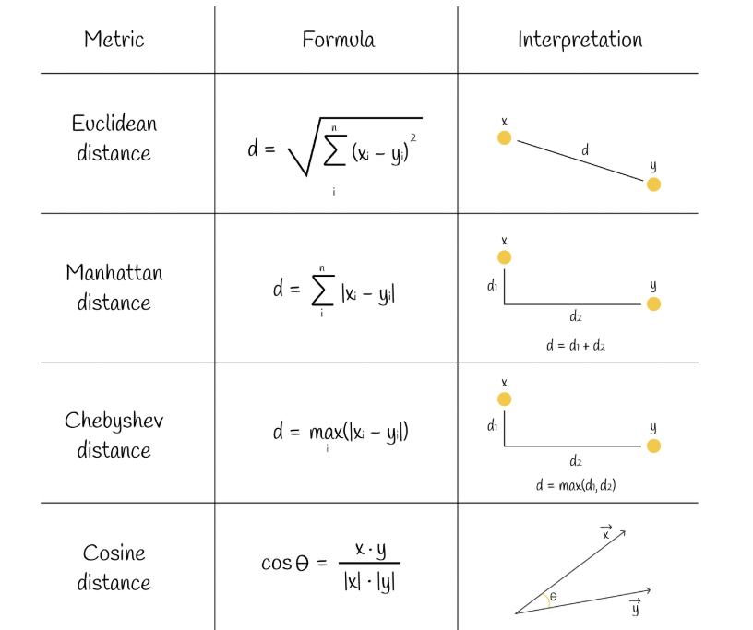
Distance and Similarity Measures

Slide 27
Introduction to Decision Trees
A Decision Tree is a supervised learning algorithm used for:
Classification
Regression
Mimics human decision-making using yes/no questions.
Each internal node = a decision on a feature
Each leaf node = a final output or class
Example: "Is age > 18?" → Yes/No → "Has license?" → Predict: Allowed or Not

Slide 28
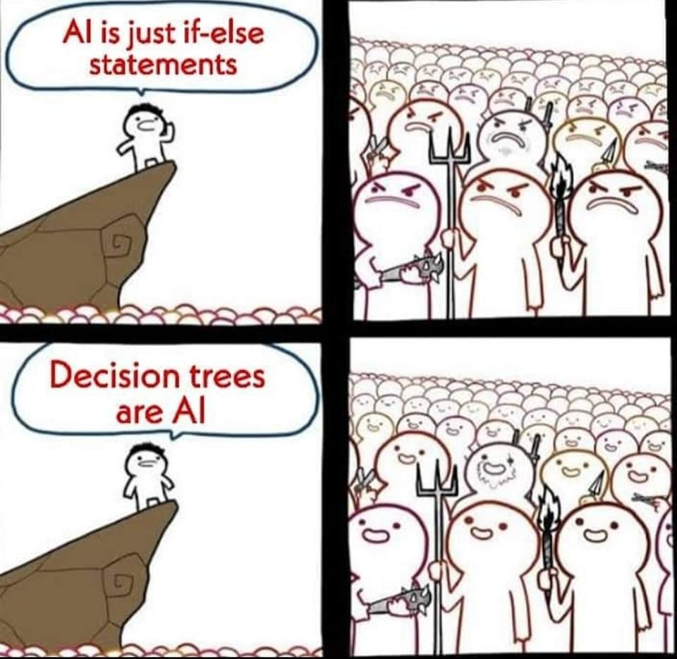
How Decision Trees Work
Select the best feature to split the data
Splitting based on purity (how mixed the classes are)
Repeat the process recursively on subsets
Common Splitting Criteria:
Gini Index (default in many libraries)
Information Gain / Entropy

Slide 29

What is Gini Impurity?
Gini Impurity measures the probability of misclassifying a randomly chosen sample in a node.
Used in decision trees to determine how “pure” or “mixed” a node is.
Lower impurity = purer node = better split
Where:
pi​ = proportion of class i in set S
c = number of classes

Slide 30
Understanding Gini Impurity
If a node has all samples from one class,
Gini Impurity = 0
If a node has an even mix (e.g., 50% Yes, 50% No),
Gini Impurity = 0.5
The maximum impurity occurs when the classes are perfectly balanced

Slide 31
Introduction to Random Forest
A Random Forest is an ensemble of Decision Trees
Builds multiple trees and aggregates their predictions
Classification → Majority vote
Regression → Average
More accurate and robust than a single decision tree

Slide 32
How Random Forest Works?
Create Many Decision Trees: The algorithm makes many decision trees each using a random part of the data. So every tree is a bit different.
Pick Random Features: When building each tree it doesn’t look at all the features (columns) at once. It picks a few at random to decide how to split the data. This helps the trees stay different from each other.
Each Tree Makes a Prediction: Every tree gives its own answer or prediction based on what it learned from its part of the data.

Slide 33
How Random Forest Works?
Combine the Predictions: For classification we choose a category as the final answer is the one that most trees agree on i.e majority voting. For regression we predict a number as the final answer is the average of all the trees predictions.

Slide 34
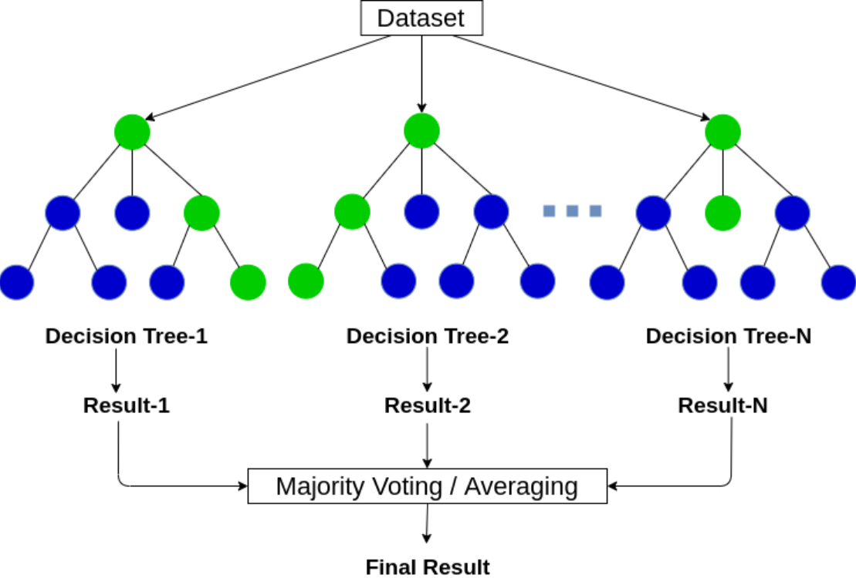

Slide 35
Thank You :)
Stay Tuned For
2nd Session

